Slide 1
Analysis of A/B Test Results
Data Scientist: Grant Collings
© 2024 Udacity.

Slide 2
Agenda
Findings of A/B test analysis
Experiment Setup
Conversion Rates
Experiment Results

Slide 3
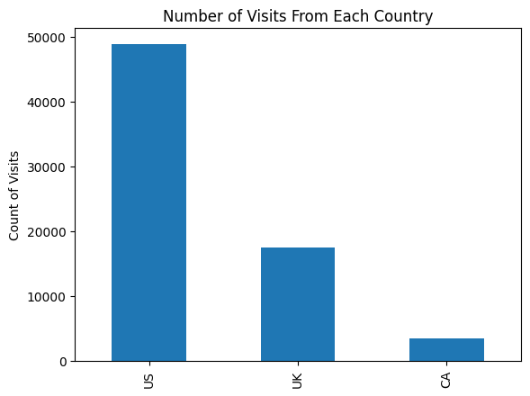
How Was the Experiment Implemented?
Total Variant Visitors: 35,211
Total Control Participants: 34,678

Slide 4
Conversion Rates
 | U.S. | U.K. | CA
Control | 10.73% | 10.16% | 9.45%
Treatment | 15.78% | 14.87% | 15.40%
Executive Summary: Key finding is that the treatment effect is positive and consistent across all countries.

Slide 5
Experiment Results
Treatment Conversion Rate: 15.53% (5,469/35,211)
Control Conversion Rate:​ 10.53% (3,650/34,678)
Delta in Treatment vs. Control Conversion Rate:​ 5%
P-value:​ <0.000001
Conclusion:
  The p-value is virtually zero, indicating the probability of observing this difference by chance alone is infinitesimally small. This is a clear, statistically significant result.

Slide 6
Business Impact
Expected Impact: +50 conversions per 1,000 users
Benefits: 47.6% relative increase in conversions, consistent across all markets, clear positive ROI potential
Considerations: Evaluate implementation costs, monitor long-term effects, plan rollout strategy

Slide 7
Recommendations
Implement the treatment
Rollout gradually to monitor for any unexpected effects
Track conversion rates to validate results
Consider A/B testing other elements to compound improvements
Document learnings for future experiments

